Slide 1

PREDICTING CUSTOMER BUYING BEHAVIOUR
1/1/2024

Slide 2
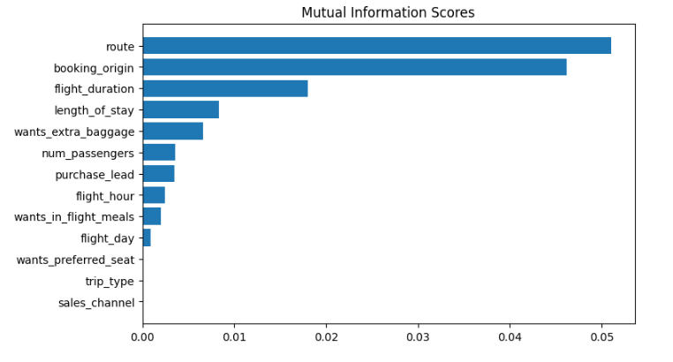
PREDICTIVE MODEL TO UNDERSTAND FACTORS THAT INFLUENCE BUYING BEHAVIOUR
We have trained the data set with Random forest classifier model and received
ACCURACY: 85.37
AUC score: 0.567
route
booking_origin
flight_duration
wants_extra_baggage
Length_of_stay
num_passengers
They are the top 6 features which influence
Customer buying behavior

